Slide 1




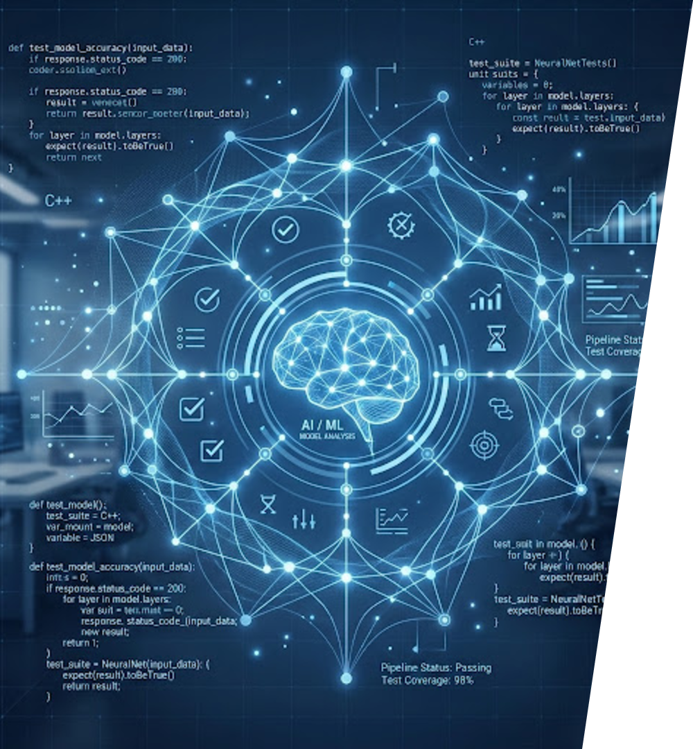
Analysis on How AI is Being Applied in Flaky Test Detection
Prepared By:
Name: Bandharam, Tharun Goud
ID: 2457134

Slide 2


Introduction
Automated testing plays a critical role in maintaining high-quality software standards.
verified
Flaky tests: Tests that produce inconsistent results without code changes, undermining trust.
report_problem
These inconsistencies increase debugging overhead and diminish overall confidence in automation suites.
biotech
AI is now vital for intelligently identifying, clustering, and analyzing these flaky behaviors.
psychology

Slide 3
What are Flaky Tests?
VISUAL EXAMPLE: INTERMITTENCY
Tests that pass and fail intermittently.
sync_problem
Run 1
check_circle
PASS
Failures occur without changes to application code.
code_off
Run 2
cancel
FAIL
category
Common Causes:
Timing & Network Instability
Environment Issues
Test Dependencies
Run 3
check_circle
PASS
Identical code, inconsistent outcomes

Slide 4

Challenges Caused by Flaky Tests
Increased Debugging Effort
Inconsistent failures require deep manual investigation.
Higher Maintenance
Constant updates to test scripts without code changes.
bug_report
build
Reduced Confidence
Teams ignore test results, leading to "false negatives."
Defect Masking
Harder to distinguish flakes from real application bugs.
sentiment_dissatisfied
search_off
CI/CD Pipeline Delays
Repeated executions slow down release cycles.
IMPACT SUMMARY
Erosion of software quality and extended release timelines due to testing friction.
speed

Slide 5





Traditional Approaches to Flaky Test Detection
Common Manual Methods
LIMITATIONS
Repeated Execution Re-running failed test cases multiple times.
Report Review Reviewing test execution reports and dashboards.
Time-consuming: Manual triage significantly slows down CI/CD cycles.
Resource Intensive: Requires deep technical effort from engineers.
Scalability Gap: Impossible to sustain for large-scale automation suites.
replay
assessment
Log Analysis Analyzing logs, traces, and screenshots.
Historical Comparison Comparing results across past test runs.
terminal
history
Environmental Investigation Investigating infrastructure, network, or timing-related issues manually.
settings_input_component

Slide 6

How AI is Applied in Flaky Test Detection
AI identifies flaky tests by analyzing historical execution data to recognize hidden patterns.
Analyze test execution history.
Detect inconsistent test behavior.
Identify recurring failure patterns.
Classify failures based on similarity.
Assist in root cause investigation.
Test Results
Historical Data
AI Pattern Recognition
Flaky Detection
Insights
description
storage
psychology
troubleshoot
lightbulb

Slide 7
Real-World Example
A login test is executed multiple times during automated regression testing. Although no changes have been made to the application code, the test produces inconsistent results.
EXECUTION HISTORY
AI ANALYSIS FLOW
AI DETECTION PROCESS
Run 1
PASS
Execution History
By analyzing historical execution results, AI identifies recurring intermittent failures and detects patterns that indicate test instability.
Based on this analysis, the test is flagged as a potential flaky test for further investigation.
Run 2
FAIL
Pattern Analysis
Run 3
PASS
Anomaly Detection
Run 4
PASS
psychology
Run 5
FAIL
Flaky Test Flagged

Slide 8

Benefits and Conclusion
Key Benefits of AI Integration
Faster Identification
Rapidly flags unstable tests
Reduced Effort
Minimizes manual triage
speed
reduce_capacity
Improved Reliability
Consistent automation results
CI/CD Stability
Seamless pipeline execution
Conclusion
AI provides an efficient, scalable approach to identifying unstable tests by analyzing historical execution patterns. As suites grow, AI-driven detection becomes vital for release quality.
verified_user
rocket_launch
thumb_up
Increased Release Confidence
Higher quality software delivered with certainty

